Slide 1
ONLINE MULTIPLE PAYMENT SYSTEM

Slide 2
ABSTRACT
In today’s fast-growing digital world, there is a strong need for payment systems that are fast, secure, and flexible. The Online Multiple Payment System (OMPS) is designed to meet this need by providing a single platform that supports different payment methods such as credit cards, debit cards, mobile wallets, net banking, and cryptocurrency.
This system improves the user experience by enabling smooth and quick transactions with strong security features. It uses advanced technologies like encryption, multi-factor authentication, and fraud detection to keep user data safe and prevent unauthorized access.
OMPS can be easily integrated with e-commerce websites, business platforms, and banking systems. It is also flexible enough to support different types of businesses such as online shopping, subscription services, and peer-to-peer payments. Additionally, it allows international transactions with currency conversion and follows global financial rules.
Overall, the system helps in reducing transaction time and cost while increasing customer satisfaction. OMPS provides a future-ready solution that can adapt to new payment technologies and trends, making online payments more efficient and reliable.

Slide 3
INTRODUCTION
The Online Multiple Payment System (OMPS) is an advanced digital platform designed to make online payments easy, secure, and flexible. In today’s world, where online shopping and digital services are increasing rapidly, people use different payment methods like credit cards, debit cards, mobile wallets, net banking, and even cryptocurrency. Managing all these separately can be difficult, so OMPS brings all these payment options into one single platform.
The main advantage of OMPS is convenience. Users can choose their preferred payment method and complete transactions quickly without switching between different systems. For businesses, it helps reduce transaction time, lower processing costs, and improve customer satisfaction by offering multiple payment choices.
Security is a major focus of OMPS. The system uses advanced technologies like encryption, multi-factor authentication, and real-time fraud detection to protect user data and ensure safe transactions. This builds trust among users and businesses.
Another important feature is scalability and flexibility. OMPS can be easily integrated with e-commerce websites, point-of-sale systems, and banking platforms. It also supports international payments with currency conversion and follows global financial regulations.
Overall, OMPS is a future-ready solution that simplifies payment processes, enhances security, and improves the overall user experience, making it highly useful in today’s digital economy.

Slide 4
EXISTING SYSTEM
Advantages
Established and reliable infrastructure
Users are familiar with payment methods (cards, net banking, wallets)
Strong security measures (encryption, fraud detection)
Widely accepted by merchants worldwide
Disadvantages
Limited support for new payment methods (e.g., cryptocurrency)
High transaction fees, especially for international payments
Slow processing time (e.g., bank transfers)
Risk of fraud, hacking, and data breaches
Lack of integration; multiple systems needed for different payments

Slide 5
PROPOSED SYSTEM
Advantages
Supports multiple payment methods (cards, wallets, net banking, cryptocurrency)
High security with encryption, MFA, and fraud detection
Lower transaction costs, especially for international payments
Faster real-time payment processing
Scalable and easy integration with existing systems
Supports global transactions with currency conversion
Future-ready and adaptable to new technologies
Disadvantages
Complex implementation and high initial setup cost
Technical challenges in maintaining security and performance
Difficulty in meeting global regulatory requirements
Users and businesses need time to adapt
Ongoing maintenance and update costs

Slide 6
SYSTEM REQUIREMENTS
HARDWARE REQUIREMENTS:
System : Pentium IV 2.4 GHz.
Hard Disk : 40 GB.
Ram : 512 Mb.
SOFTWARE REQUIREMENTS:
Operating system : Windows.
Coding Language : python.

Slide 7
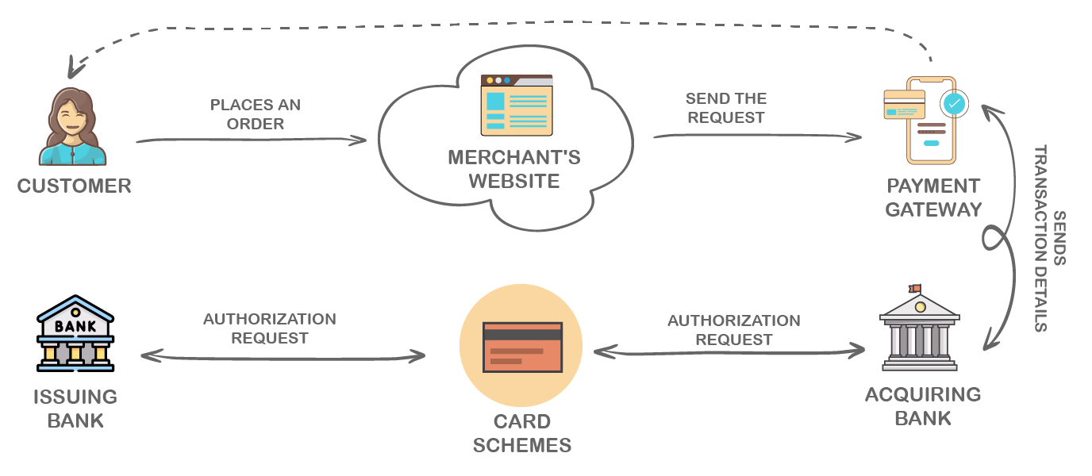
SYSTEM ARCHITECTURE

Slide 8
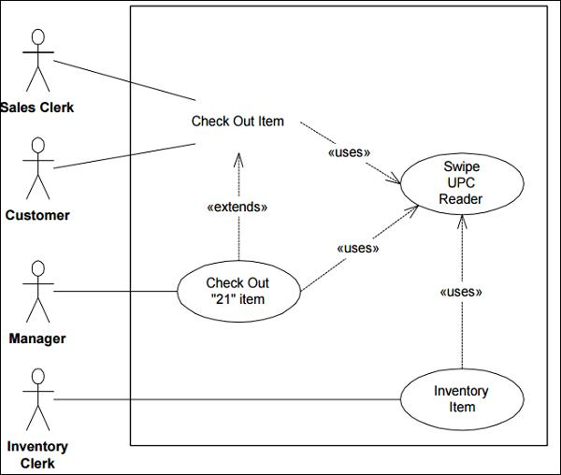
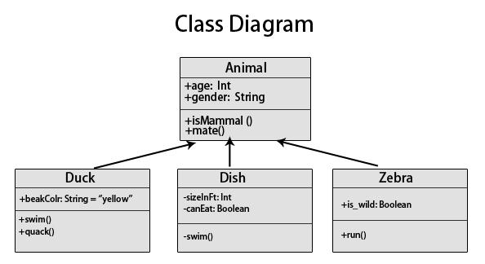
UML DIAGRAMS
CLASS DIAGRAM
USECASE DIAGRAM

Slide 9
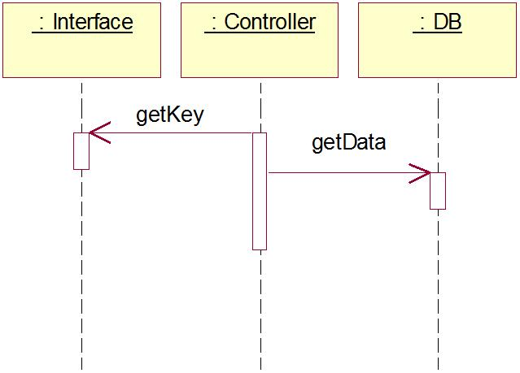
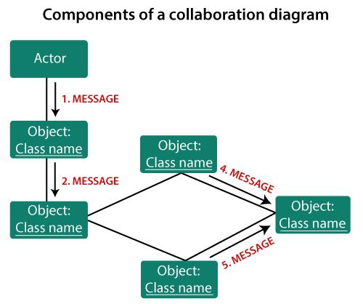
UML DIAGRAMS
SEQUENCE DIAGRAM
COLLABORATION DIAGRAM

Slide 10
SYSTEM STUDY
Feasibility Study
Overview
Evaluates whether the proposed system is practical and beneficial
Ensures system is not a burden on the organization
Includes basic planning, cost estimation, and requirement analysis
Types of Feasibility
Economical Feasibility
Checks cost and financial impact on organization
Ensures project stays within budget
Uses mostly free technologies to reduce cost
Technical Feasibility
Analyzes technical requirements and resources
Ensures system works with existing infrastructure
Requires minimal changes for implementation
Social Feasibility
Measures user acceptance and usability
Provides training and support to users
Builds confidence and encourages user feedback

Slide 11
TESTING
System Testing Overview
Purpose of Testing
Identifies errors and weaknesses in the system
Ensures software meets requirements and user expectations
Validates functionality of components and overall system
Types of Testing
Unit Testing – Tests individual components
Integration Testing – Tests combined modules
Functional Testing – Checks system functions
System Testing – Validates complete system
White Box Testing – Tests internal logic
Black Box Testing – Tests without internal knowledge

Slide 12
TESTING
Testing Strategy & Results
Test Strategy & Objectives
Manual field testing and detailed functional tests
Ensure:
All inputs work correctly
Pages load properly
No delay in response
Features Tested
Correct data format validation
No duplicate entries
Proper navigation of all links
Results
Integration Testing: No errors found
Acceptance Testing: Passed successfully
System meets all functional requirements

Slide 13
CONCLUSION
The Online Multiple Payment System (OMPS) is a modern solution that improves the way digital payments are made. It combines different payment methods like cards, mobile wallets, net banking, and cryptocurrency into one platform, making transactions more convenient for users and businesses.
The system also focuses on security by using technologies like encryption, multi-factor authentication, and fraud detection to protect user data. In addition, it supports faster transactions and reduces costs, which is very useful in today’s global digital market.
Although there are some challenges such as system complexity, regulatory issues, and user adaptation, the advantages are much greater. OMPS provides better user experience, scalability, and the ability to adapt to future technologies.
Overall, OMPS is a reliable and future-ready system that has the potential to transform digital payment systems.

